Slide 1


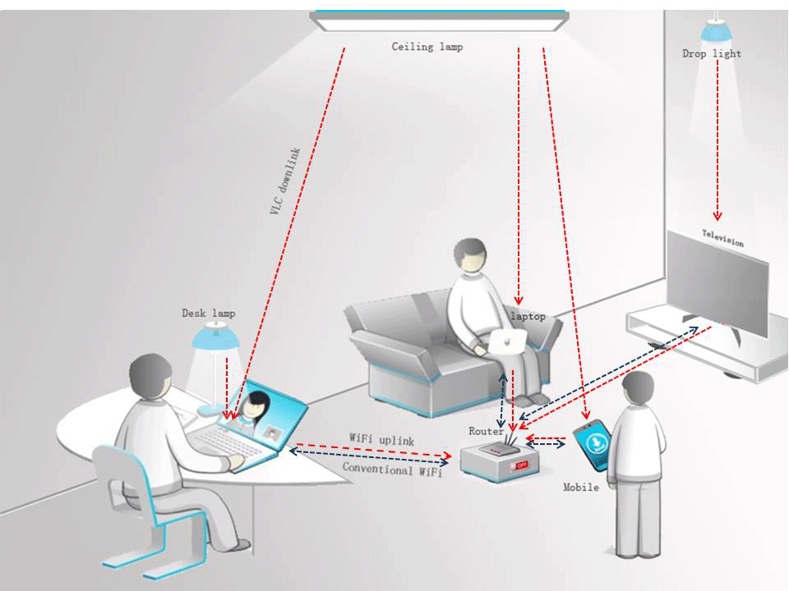
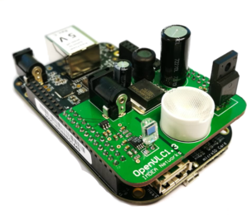


Li-Fi Communication
ECE 403 Senior Design
Sacdiya Sayid (EL)
Nelson Caberto (TL)
Visible Light Wi-Fi: Li-Fi uses visible light to transmit data between devices. Li-Fi is an emerging technology for indoor communication.
Greg Graham (IM)

Slide 2
Deliverables
What is your test methodology?
Tested sending a bit, byte, and a string. To do this we had to test ambient light values, distance, and brightness using various LEDs. We switched to RGB LEDs for our Half Duplex setup. Having RGB we have settled on 4 brightness levels. Currently on Arduino we have changed out photoresistor to photodiode and working on implementing MOSFETs and ADC chips with OP amp to TX and RX respectively to provide more consistent results. On Raspberry Pi, Nelson has created a web interface for sending messages. We have tested each step by trying to send a bit, byte, or char and now we need to update our circuits and do the same. As well finish troubleshooting the capes with BBBs.

Slide 3


Results
What are your preliminary test results?
Test Results on Raspberry Pi using web interface.

Slide 4
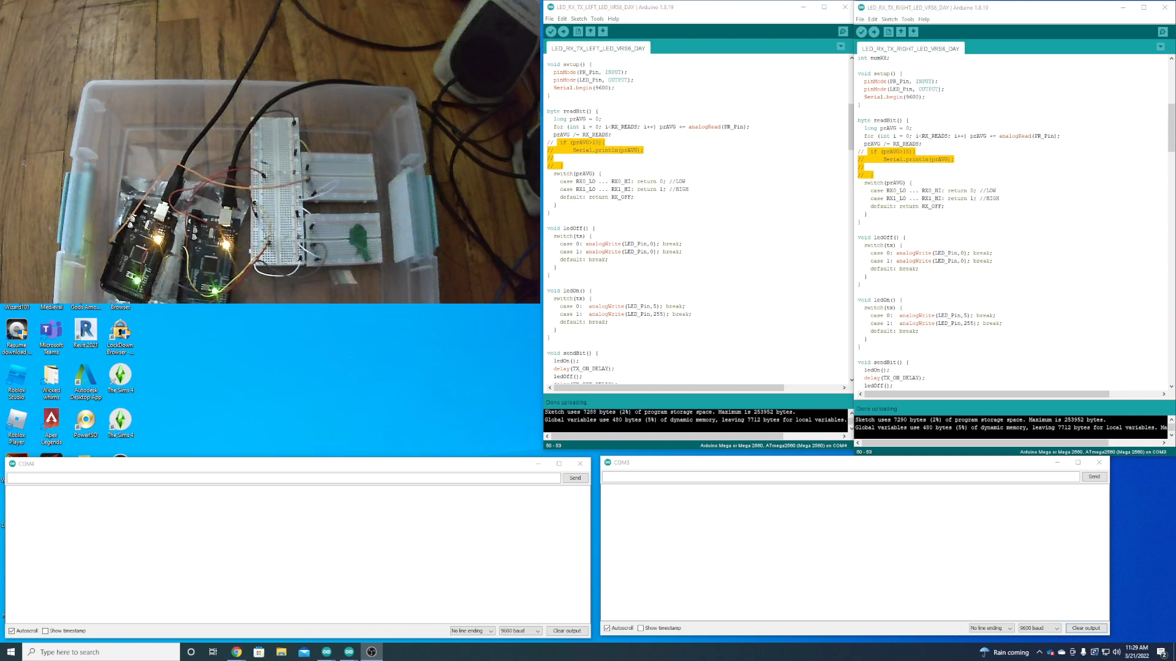
Results
What are your preliminary test results?
Test Results on Arduino

Slide 5
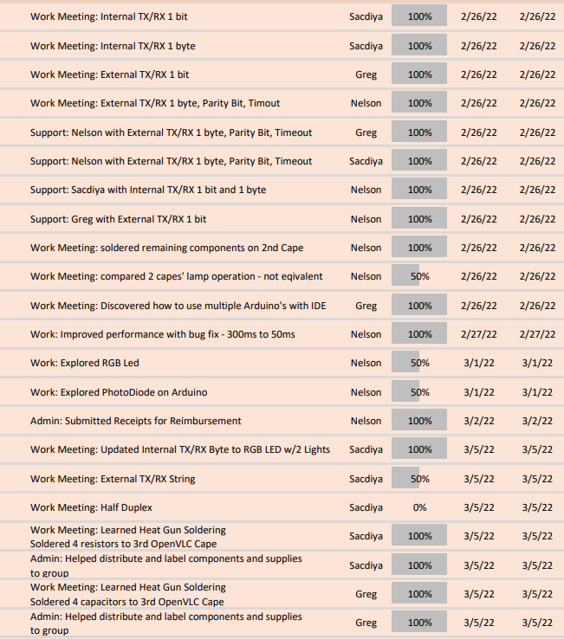
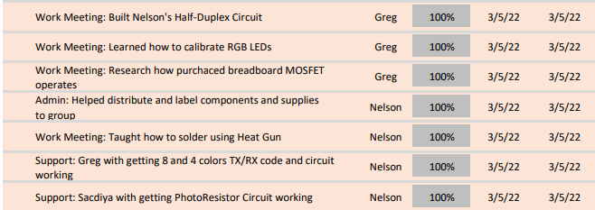
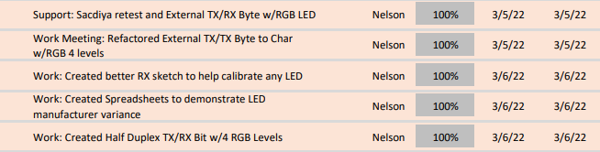
Individual Accomplishments

Slide 6
Task Division for Upcoming Weeks
Greg:
Troubleshooting Capes with BBBs
Upgrading TX and RX circuits with MOSFETS and ADCs respectively
Nelson:
Soldering ADCs for Arduinos
Troubleshooting Capes’ Hardware
Practical Demo of 2 computers communicating
Sacdiya:
Updating TX and RX code with addition of MOSFETS and ADCs
Helping with practical demo of 2 computers communicating
All:
Working on Final Paper and Video Presentation

Slide 7
Individual Accomplishments
Nelson:
- Completed OpenVLC Cape #3
- Half-duplex – RGB PD 4 colors
- Trip to microcenter to pick up rpi 400
- Started flask
- Finished basic web interface
- Delivered MOSFETs and C10 to Greg and Sacdiya
- Raspberry Pi
Changed from value to voltage for photodiode reading
Ported – TX byte code
Ported – TX byte with parity bit code
Ported – RX byte with parity bit code
Ported – TXCR char code
Created – TXCR string code
Sacdiya:
- Half Duplex code for transmitting and receiving using 4MM adafruit LEDs
- Troubleshooted with various LEDS
- Sent String using Half duplex
- Wrote 4 versions of Half-duplex code
- Recompiling the string character by character, and displaying it on the monitor in character form
- Can send a string of any length
- Can send acknowledgement but not consistently
- Added shorter delays
- Recorded demo of new code
-Recalibrated string code for brightness levels
- Created a final paper outline as a guide to help us write our final paper
Greg:
-Built a circuit to test functionality of MOSFET
-Test and Recorded Data (using Nelson TX/RX code):
With various LEDs, Resistors, and with the MOSFETS
- Tested distance with best setup
- Ordered 12-bit ADC and researched how to use with Arduino
-Tested Photodiode to get ambience and various light values
- Build multiple circuits to test ADC on the RX and MOSFET on TX; (Still in progress)

